Slide 1

Chapter 3 GridArchitecture
3.1 Hourglass Model
3.2 OGSA

Slide 2
a Grid architecture that identifies fundamental system components, specifies the purpose and function of these components, and indicates how these components interact with one another.

Slide 3
3.1 Hourglass Model
Gird Protocol Architecture
Application
Application
Internet Protocol Architecture
Collective
Resource
Transport
Connectivity
Internet
Fabric
Link
The layered Grid architecture and its relationship to the Internet protocol architecture.

Slide 4
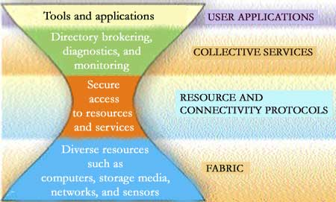
3.1 Hourglass Model

Slide 5
3.1.1 Fabric
The Grid Fabric layer provides the resources to which shared access is mediated by Grid protocols
  computational resources
  storage systems
  catalogs
  network resources
  sensors
  a distributed file system
  computer cluster
  distributed computer pool

Slide 6
3.1.1 Fabric
Fabric components implement the local, resource-specific operations that occur on specific resources (whether physical or logical) as a result of sharing operations at higher levels.

Slide 7
3.1.1 Fabric
(1) Computational resources
Mechanisms are required for starting programs and for monitoring and controlling the execution of the resulting processes.
Management mechanisms that allow control over the resources allocated to processes are useful, as are advance reservation mechanisms.

Slide 8
3.1.1 Fabric
Enquiry functions are needed for determining hardware and software characteristics as well as relevant state information such as current load and queue state in the case of scheduler-managed resources.

Slide 9
3.1.1 Fabric
(2) Storage resources
Mechanisms are required for putting and getting files, for reading and writing subsets of a file and/or executing remote data selection or reduction functions.

Slide 10
3.1.1 Fabric
Management mechanisms that allow control over the resources allocated to data transfers (space, disk bandwidth, network bandwidth, CPU) are useful, as are advance reservation mechanisms.
Enquiry functions are needed for determining hardware and software characteristics as well as relevant load information such as available space and bandwidth utilization.

Slide 11
3.1.1 Fabric
(3) Network resources
Management mechanisms that provide control over the resources allocated to network transfers (e.g., prioritization, reservation) can be useful.
Enquiry functions should be provided to determine network characteristics and load.

Slide 12
3.1.1 Fabric
(4) Code repositories: This specialized form of storage resource requires mechanisms for managing versioned source and object code: for example, a control system such as CVS.
(5) Catalogs: This specialized form of storage resource requires mechanisms for implementing catalog query and update operations: for example, a relational database

Slide 13
3.1.2 Connectivity
The Connectivity layer defines core communication and authentication protocols required for Grid-specific network transactions.
Communication protocols enable the exchange of data between Fabric layer resources.
Authentication protocols build on communication services to provide cryptographically secure mechanisms for verifying the identity of users and resources.

Slide 14
3.1.2 Connectivity
Communication requirements include transport, routing, and naming.
TCP/IP protocol stack: the Internet (IP and ICMP), transport (TCP, UDP), and application (DNS, OSPF, RSVP, etc.) layers of the Internet layered protocol architecture.

Slide 15
3.1.2 Connectivity
Authentication solutions for VO environments should have the following characteristics:
  Single sign on
Users must be able to “log on” (authenticate) just once and then have access to multiple Grid resources defined in the Fabric layer, without further user intervention.

Slide 16
3.1.2 Connectivity
  Delegation
A user must be able to endow a program with the ability to run on that user’s behalf, so that the program is able to access the resources on which the user is authorized.
The program should (optionally) also be able to conditionally delegate a subset of its rights to another program (sometimes referred to as restricted delegation).
Notes:
endow: 赋予

Slide 17
3.1.2 Connectivity
  Integration with various local security solutions
Each site or resource provider may employ any of a variety of local security solutions, including Kerberos and Unix security. Grid security solutions must be able to interoperate with these various local solutions. They cannot, realistically, require wholesale replacement of local security solutions but rather must allow mapping into the local environment.

Slide 18
3.1.2 Connectivity
  User-based trust relationships
In order for a user to use resources from multiple providers together, the security system must not require each of the resource providers to cooperate or interact with each other in configuring the security environment.
For example, if a user has the right to use sites A and B, the user should be able to use sites A and B together without requiring that A’s and B’s security administrators interact.

Slide 19
3.1.3 Resource
The Resource layer builds on Connectivity layer communication and authentication protocols to define protocols (and APIs and SDKs) for the secure negotiation, initiation, monitoring, control, accounting, and payment of sharing operations on individual resources.

Slide 20
3.1.3 Resource
Resource layer implementations of these protocols call Fabric layer functions to access and control local resources.
Resource layer protocols are concerned entirely with individual resources and hence ignore issues of global state and atomic actions across distributed collections; such issues are the concern of the Collective layer discussed next.

Slide 21
3.1.4 Collective
While the Resource layer is focused on interactions with a single resource, the Collective layer in the architecture contains protocols and services (and APIs and SDKs) that are not associated with any one specific resource but rather are global in nature and capture interactions across collections of resources.

Slide 22
3.1.4 Collective
Because Collective components build on the narrow Resource and Connectivity layer “neck” in the protocol hourglass, they can implement a wide variety of sharing behaviors without placing new requirements on the resources being shared.

Slide 23
3.1.4 Collective
These examples illustrate the wide variety of Collective layer protocols and services :
  Directory services allow VO participants to discover the existence and/or properties of VO resources.
  Co-allocation, scheduling, and brokering services allow VO participants to request the allocation of one or more resources for a specific purpose and the scheduling of tasks on the appropriate resources.

Slide 24
3.1.4 Collective
  Monitoring and diagnostics services support the monitoring of VO resources for failure, adversarial attack (“intrusion detection”), overload, and so forth.
  Data replication services support the management of VO storage resources to maximize data access performance with respect to metrics such as response time, reliability, and cost.

Slide 25
3.1.4 Collective
  Grid-enabled programming systems enable familiar programming models to be used in Grid environments.
  Workload management systems and collaboration frameworks—also known as problem solving environments (“PSEs”)—provide for the description, use, and management of multi-step, asynchronous, multi-component workflows

Slide 26
3.1.4 Collective
  Software discovery services discover and select the best software implementation and execution platform based on the parameters of the problem being solved.
  Community authorization servers enforce community policies governing resource access, generating capabilities that community members can use to access community resources.

Slide 27
3.1.4 Collective
  Community accounting and payment services gather resource usage information for the purpose of accounting, payment, and/or limiting of resource usage by community members.
  Collaboratory services support the coordinated exchange of information within potentially large user communities, whether synchronously or asynchronously.

Slide 28
3.1.5 Applications
The final layer in our Grid architecture comprises the user applications that operate within a VO environment.

Slide 29
3.2 OGSA
3.2.1 Introduction
  A target environment that was homogeneous, reliable, secure, and centrally managed.
  Collaboration, data sharing, and other new modes of interaction that involve distributed resources.
  The interconnection of systems both within and across enterprises

Slide 30
3.2.1 Introduction
Integrated resource management functions to database integration, clustering services, security, workload management, and problem determination
We require new abstractions and concepts that allow applications to access and share resources and services across distributed, wide area networks.

Slide 31
3.2.1 Introduction
Grid technologies and infrastructures as supporting the sharing and coordinated use of diverse resources in dynamic, distributed "Virtual organizations"(VOs)
  Fabric
  Connectivity
  Resource
  Collective

Slide 32
3.2.1 Introduction
Extend this argument in three respects
(1) Services
A grid is an extensible set of Grid services that may be aggregated in various ways to meet the needs of VOs, which themselves can be defined in part by the services that they operate and share.

Slide 33
3.2.1 Introduction
(2) Grid technologies can be aligned with Web services technologies
  service description and discovery;
  automatic generation of client and server code from service descriptions;
  binding of service descriptions to interoperable network protocols;
  compatibility with emerging higher-level open standards, services and tools;
  broad commercial support.

Slide 34
3.2.1 Introduction
Open Grid Services Architecture
This architecture uses the Web Services Description Language (WSDL) to achieve self-describing, discoverable services and interoperable protocols, with extensions to support multiple coordinated interfaces and change management.

Slide 35
3.2.1 Introduction
OGSA leverages experience gained with the Globus Toolkit to define conventions and WSDL interfaces for a Grid service, a (potentially transient) stateful service instance supporting reliable and secure invocation, lifetime management, notification, policy management, credential management, and virtualization.

Slide 36
3.2.1 Introduction
OGSA also defines interfaces for the discovery of Grid service instances and for the creation of transient Grid service instances.
The result is a standards-based distributed service system that supports the creation of the sophisticated distributed services required in modern enterprise and interorganizational computing environments.

Slide 37
3.2.1 Introduction
(3) Commercial applications
The same principles and mechanisms apply in both environments.
OGSA's support for the discovery of service properties facilitates the mapping or adaptation of higher-level Grid service functions to such native platform facilities

Slide 38
3.2.1 Introduction
OGSA's service orientation also allows us to virtualize resources at multiple levels, so that the same abstractions and mechanisms can be used both within distributed Grids supporting collaboration across organizational domains and within hosting environments spanning multiple tiers within a single IT domain.

Slide 39
3.2.2 Background
The Open Grid Services Architecture:
the Globus Toolkit, which has been widely adopted as a Grid technology solution for scientific and technical computing
Web services, which have emerged as a popular standards-based framework for accessing network applications.

Slide 40
3.2.2 Background
The term Web services describes an important emerging distributed computing paradigm that differs from other approaches such as DCE, CORBA, and Java RMI in its focus on simple, Internet-based standards (XML) to address heterogeneous distributed computing.

Slide 41
3.2.2 Background
Web services define a technique for describing software components to be accessed, methods for accessing these components, and discovery methods that enable the identification of relevant service providers.
Web services are programming language-, programming model-, and system software-neutral.

Slide 42
3.2.2 Background
Web services
SOAP
WSDL
WS-Inspection

Slide 43
3.2.2 Background
The Simple Object Access Protocol (SOAP) provides a means of messaging between a service provider and a service requestor.
SOAP is a simple enveloping mechanism for XML payloads that defines a remote procedure call (RPC) convention and a messaging convention.

Slide 44
3.2.2 Background
SOAP is independent of the underlying transport protocol; SOAP payloads can be carried on HTTP, FTP, Java Messaging Service (JMS), and the like.
We emphasize that Web services can describe multiple access mechanisms to the underlying software component. SOAP is just one means of formatting a Web service invocation.

Slide 45
3.2.2 Background
The Web Services Description Language (WSDL) is an XML document for describing Web services as a set of endpoints operating on messages containing either document-oriented (messaging) or RPC payloads.
Service interfaces are defined abstractly in terms of message structures and sequences of simple message exchanges and then bound to a concrete network protocol and data-encoding format to define an endpoint.

Slide 46
3.2.2 Background
WS-Inspection comprises a simple XML language and related conventions for locating service descriptions published by a service provider.

Slide 47
3.2.2 Background
A WS-Inspection language (WSIL) document can contain a collection of service descriptions and links to other sources of service descriptions. A service description is usually a URL to a WSDL document; occasionally, a service description can be a reference to an entry within a Universal Description, Discovery, and Integration (UDDI) registry.

Slide 48
3.2.2 Background
The Web services framework has two advantages:
  Our need to support the dynamic discovery and composition of services in heterogeneous environments necessitates mechanisms for registering and discovering interface definitions and endpoint implementation descriptions and for dynamically generating proxies based on bindings for specific interfaces.

Slide 49
3.2.2 Background
  The widespread adoption of Web services mechanisms means that a framework based on Web services can exploit numerous tools and extant services

Slide 50
3.2.3 Open Grid Services Architecture
an Open Grid Services Architecture supports the creation, maintenance, and application of ensembles of services maintained by VOs.
  A service-oriented Grid architecture
  Virtualize Grid services
  Grid service
Notes:
ensemble:整体，综合

Slide 51
(1) Service Orientation and Virtualization
Hourglass model | OGSA
protocol-oriented | service-oriented
the physical resources being shared or on the services supported by these resources. | Services: computational resources, storage resources, networks, programs, databases, and the like are all represented as services.

Slide 52
A critical requirement in a distributed, multiorganizational Grid environment is for mechanisms that enable interoperability.
In a service-oriented view, we can partition the interoperability problem into two subproblems:
  The definition of service interfaces
  The identification of the protocol(s) that can be used to invoke a particular interface -- and agreement on a standard set of such protocols.

Slide 53
A service-oriented view allows us to address the need for standard interface definition mechanisms, local/remote transparency, adaptation to local OS services, and uniform service semantics.
A service-oriented view also simplifies virtualization --that is, the encapsulation behind a common interface of diverse implementations.

Slide 54
Virtualization allows for consistent resource access across multiple heterogeneous platforms with local or remote location transparency, and enables mapping of multiple logical resource instances onto the same physical resource and management of resources within a VO based on composition from lower-level resources.

Slide 55
Virtualization allows the composition of services to form more sophisticated services --without regard for how the services being composed are implemented.
Virtualization of Grid services also underpins the ability to map common service semantic behavior seamlessly onto native platform facilities.

Slide 56
Virtualization is easier if service functions can be expressed in a standard form, so that any implementation of a service is invoked in the same manner.

Slide 57
The service interface definition and access binding are also distinct from the implementation of the functionality of the service.
A service can support multiple implementations on different platforms, facilitating seamless overlay not only to native platform facilities but also to virtual ensembles of resources.

Slide 58
Depending on the platform and context, we might use the following implementation approaches.
  Use a reference implementation constructed for full portability across multiple platforms to support the execution environment (container) for hosting a service.
  On a platform possessing specialized native facilities for delivering service functionality, we might map from the service interface definition to the native platform facilities.

Slide 59
  Apply these mechanisms recursively so that a higher-level service is constructed by the composition of multiple lower-level services, which themselves may either map to native facilities or decompose further. The service implementation then dispatches operations to lower-level services

Slide 60
3.2.4 The Grid Service
A Grid service: a Web service that provides a set of well-defined interfaces and that follows specific conventions.
  The interfaces address discovery, dynamic service creation, lifetime management, notification, and manageability;
  The conventions address naming and upgradeability.

Slide 61
3.2.4 The Grid Service
The interfaces and conventions that define a Grid service are concerned, in particular, with behaviors related to the management of transient service instances.
VO participants typically maintain not merely a static set of persistent services that handle complex activity requests from clients.

Slide 62
3.2.4 The Grid Service
They often need to instantiate new transient service instances dynamically, which then handle the management and interactions associated with the state of particular requested activities. When the activity's state is no longer needed, the service can be destroyed.

Slide 63
We expect also to address authorization and concurrency control as OGSA evolves. Two other important issues, authentication and reliable invocation, are viewed as service protocol bindings and are thus external to the core Grid service definition, but must be addressed within a complete OGSA implementation.

Slide 64
3.2.4.1 Upgradeability Conventions and Transport Protocols
Services within a complex distributed system must be independently upgradeable.
Versioning and compatibility between services must be managed and expressed so that clients can discover not only specific service versions but also compatible services.
Further, services must be upgradeable without disrupting the operation of their clients.

Slide 65
OGSA defines conventions that allow us to identify when a service changes and when those changes are backwardly compatible with respect to interface and semantics (but not necessarily network protocol).
OGSA also defines mechanisms for refreshing a client's knowledge of a service, such as what operations it supports or what network protocols can be used to communicate with the service.

Slide 66
A service's description indicates the protocol binding(s) that can be used to communicate with the service.
Two properties will often be desirable in such bindings.
  Reliable service invocation.
  Authentication

Slide 67
3.2.4.2 Standard Interfaces
(1) Grid Service
  FindServiceData
  Query a variety of information about the Grid service instance, including basic introspection information, richer per-interface information, and service-specific information. Extensible support for various query languages.

Slide 68
  SetTerminationTime
  Set (and get) termination time for Grid service instance
  Destroy
  Terminate Grid service instance

Slide 69
(2) NotificationSource
  SubscribeToNotificationTopic
  Subscribe to notifications of service-related events, based on message type and interest statement. Allows for delivery via third party messaging services.

Slide 70
(3) NotificationSink
  DeliverNotification
  Carry out asynchronous delivery of notification messages

Slide 71
(4) Registry
  RegisterService
  Conduct soft-state registration of Grid service handles
  UnregisterService
  Deregister a Grid service handle

Slide 72
(5) Factory
  CreateService
  Create new Grid service instance
(6) HandleMap
  FindByHandle
  Return Grid Service Reference currently associated with supplied Grid Servece Handle

Slide 73
1. Discovery
Applications require mechanisms for discovering available services and for determining the characteristics of those services so that they can configure themselves and their requests to those services appropriately

Slide 74
We address this requirement by defining
  a standard representation for service data, that is, information about Grid service instances, which we structure as a set of named and typed XML elements called service data elements, encapsulated in a standard container format;

Slide 75
  a standard operation, FindServiceData (within the required GridService interface), for retrieving service data from individual Grid service instances
  standard interfaces for registering information about Grid service instances with registry services (Registry) and for mapping from “handles” to “references”

Slide 76
2. Dynamic service creation
The ability to dynamically create and manage new service instances is a basic tenet of the OGSA model and necessitates the existence of service creation services.
The OGSA model defines a standard interface (Factory) and semantics that any service creation service must provide.
Notes:
tenet:原则

Slide 77
3. Lifetime management
Any distributed system must be able to deal with inevitable failures. In a system that incorporates transient, stateful service instances, mechanisms must be provided for reclaiming services and state associated with failed operations.
  Destroy
  SetTerminationTime

Slide 78
4. Notification
A collection of dynamic, distributed services must be able to notify each other asynchronously of interesting changes to their state

Slide 79
OGSA defines common abstractions and service interfaces for subscription to (NotificationSource) and delivery of (NotificationSink) such notifications, so that services constructed by the composition of simpler services can deal with notifications in standard ways.

Slide 80
5. Other interfaces
We expect to define additional standard interfaces in the near future, to address issues such as authorization, policy management, concurrency control, and the monitoring and management of potentially large sets of Grid service instances.

Slide 81
3.2.5 The Role of Hosting Environments
OGSA defines the semantics of a Grid service instance: how it is created, how it is named, how its lifetime is determined, how to communicate with it, and so on.
OGSA does not address issues of implementation programming model, programming language, implementation tools, or execution environment.

Slide 82
In practice, Grid services are instantiated within a specific execution environment or hosting environment. A particular hosting environment defines not only implementation programming model, programming language, development tools, and debugging tools, but also how an implementation of a Grid service meets its obligations with respect to Grid service semantics.

Slide 83
Today's e-science Grid applications typically rely on native operating system processes as their hosting environment, with for example creation of a new service instance involving the creation of a new process. In such environments, a service itself may be implemented in a variety of languages such as C, C++, Java, or Fortran.

Slide 84
Web services may be implemented on more sophisticated container or component-based hosting environments such as J2EE, Websphere, .NET, and Sun One.
Such environments define a framework (container) within which components adhering to environment-defined interface standards can be instantiated and composed to build complex applications.

Slide 85
In the OGSA context, the container (hosting environment) has primary responsibility for ensuring that the services it supports adhere to Grid service semantics, and thus OGSA may motivate modifications or additions to the container/component interface.

Slide 86
By defining service semantics, OGSA specifies interactions between services in a manner independent of any hosting environment.
Successful implementation of Grid services can be facilitated by specifying baseline characteristics that all hosting environments must possess, defining the "internal" interface from the service implementation to the global Grid environment.

Slide 87
We can expect a hosting environment to address
  mapping of Grid-wide names into implementation-specific entities (C pointers, Java object references, etc.);
  dispatch of Grid invocations and notification events into implementation-specific actions (events, procedure calls);
  protocol processing and the formatting of data for network transmission;
  lifetime management of Grid service instances; and inter-service authentication.

Slide 88
3.2.6 Using OGSA Mechanisms to Build VO Structures
OGSA Factory, Registry, GridService, and HandleMap interfaces support the creation of transient service instances and the discovery and characterization of the service instances associated with a VO.

Slide 89
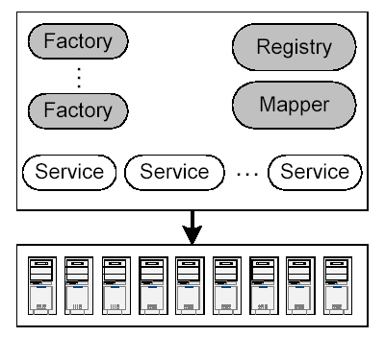
Simple hosting environment

Slide 90
1. Simple hosting environment
A simple execution environment is a set of resources located within a single administrative domain and supporting native facilities for service management: for example, a J2EE application server, Microsoft .NET system, or Linux cluster.

Slide 91
In OGSA, the user interface to such an environment will typically be structured as a registry, one or more factories, and a handleMap service.
Each factory is recorded in the registry, to enable clients to discover available factories.

Slide 92
When a factory receives a client request to create a Grid service instance, the factory invokes hosting-environment-specific capabilities to create the new instance, assigns it a handle, registers the instance with the registry, and makes the handle available to the handleMap service.
The implementations of these various services map directly into local operations.

Slide 93
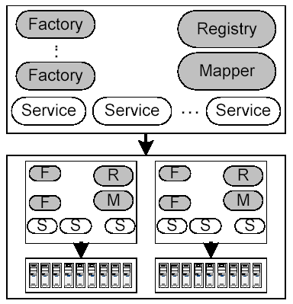
Virtual hosting environment.

Slide 94
2. Virtual hosting environment
In more complex environments, the resources associated with a VO will span heterogeneous, geographically distributed "hosting environments"
(For example, in Figure 2, these resources span two simple hosting environments.)

Slide 95
This "Virtual hosting environment" can be made accessible to a client via exactly the same interfaces as were used for the hosting environment just described.
  One or more "higher-level" factories that delegate creation requests to lower-level factories.

Slide 96
  A higher-level registry that knows about the higher-level factories and the service instances that they have created, as well any VO-specific policies that govern the use of VO services.

Slide 97
  Clients can then use the VO registry to find factories and other service instances associated with the VO, and then use the handles returned by the registry to talk directly to those service instances.
  The higher-level factories and registry implement standard interfaces and so, from the perspective of the user, are indistinguishable from any other factory or registry.

Slide 98
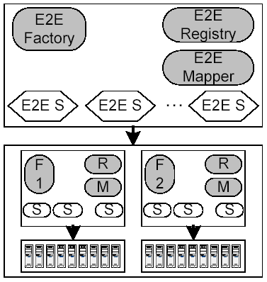
Collective operations

Slide 99
3. Collective operations
We can also construct a "virtual hosting environment" that provides VO participants with more sophisticated, virtual, "collective" or "end-to-end" services.

Slide 100
In this case, the registry keeps track of and advertises factories that create higher-level service instances.
Such instances are implemented by asking lower-level factories to create multiple service instances and by composing the behaviors of those multiple lower-level service instances into that single, higher-level service instance.

Slide 101
Implementations of Grid services that map to native platform resources and APIs enable seamless integration of higher-level Grid services such as those just described with underlying platform components.
Service sets associated with multiple VOs can map to the same underlying physical resources, with those services represented as logically distinct at one level but sharing physical resource systems at lower levels.

Slide 102
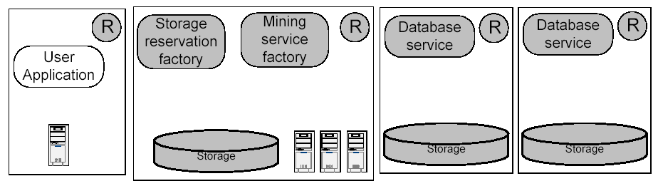
4 Application Example

Slide 103
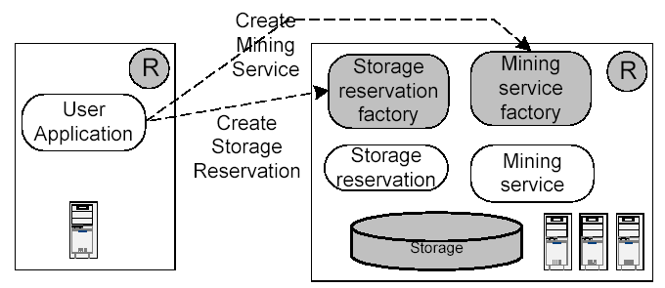

Slide 104
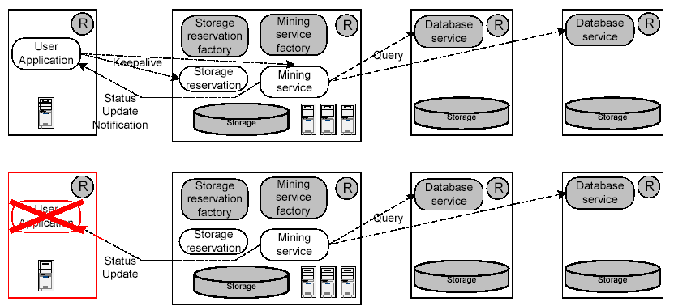

Slide 105
3.2.7 Technical Details
3.2.7.1 The OGSA Service Model
Everything is represented by a service: a network enabled entity that provides some capability through the exchange of messages.
This adoption of a uniform service-oriented model means that all components of the environment are virtual.

Slide 106
OGSA represents everything as a Grid service:
a Web service that conforms to a set of conventions and supports standard interfaces for such purposes as lifetime management.
This core set of consistent interfaces, from which all Grid services are implemented, facilitates the construction of higher-order services that can be treated in a uniform way across layers of abstraction.

Slide 107
  Grid services are characterized (typed) by the capabilities that they offer.
  A Grid service implements one or more interfaces
  Grid service interfaces correspond to portTypes in WSDL. serviceType
  Grid services can maintain internal state for the lifetime of the service.

Slide 108
  Grid service instance is refered to a particular instantiation of a Grid service.
  The protocol binding associated with a service interface can define a delivery semantics
  Another frequently desirable protocol binding behavior is mutual authentication during communication.

Slide 109
  OGSA services can be created and destroyed dynamically.
  Every Grid service instance is assigned a globally unique name, the Grid service handle (GSH)
  Grid services may be upgraded during their lifetime to support new protocol versions or to add alternative protocols.

Slide 110
  The GSH carries no protocol- or instance-specific information such as network address and supported protocol bindings. Instead, this information is encapsulated, along with all other instance-specific information required to interact with a specific service instance, into a single abstraction called a Grid service reference (GSR).

Slide 111
  A GSH is invariant
  The GSR(s) for a Grid service instance can change over that service's lifetime. A GSR has an explicit expiration time, or may become invalid at any time during a service's lifetime, and OGSA defines mapping mechanisms for obtaining an updated GSR

Slide 112
  A valid GSR does not guarantee access to a Grid service instance:
    local policy or access control constraints may prohibit servicing a request.
    In addition, the referenced Grid service instance may have failed, preventing the use of the GSR.

Slide 113
3.2.7.2 Creating Transient Services: Factories
Factory interface
A service that implements this interface a factory.
The Factory interface's CreateService operation creates a requested Grid service and returns the GSH and initial GSR for the new service instance

Slide 114
The Factory interface does not specify how the service instance is created.
One common scenario is for the factory interface to be implemented in some form of hosting environment (such as .NET or J2EE) that provides standard mechanisms for creating (and subsequently managing) new service instances.

Slide 115
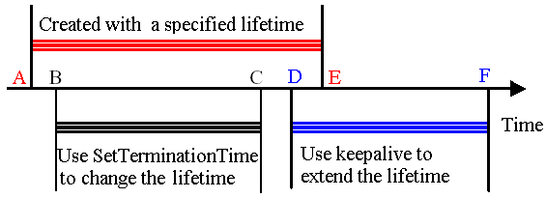
3.2.7.3 Service Lifetime Management
Determining the service's lifetime
A soft state approach

Slide 116
  Negotiating an initial lifetime.
  Requesting a lifetime extension.
SetTerminationTime
Keepalive messages

Slide 117
Two desirable properties:
  A client knows, or can determine, when a Grid service instance will terminate.
  A hosting environment is guaranteed that resource consumption is bounded, even in the face of system failures outside of its control.

Slide 118
3.2.7.4 Managing Handles and References
While the GSH is guaranteed to reference the created Grid service instance in perpetuity, the GSR is created with a finite lifetime and may change during the service's lifetime.
Notes:
perpetuity:永久，永恒

Slide 119
A handle-to-reference mapper interface (HandleMap).
The operations provided by this interface take a GSH and return a valid GSR.
Mapping operations can be access controlled and thus a mapping request may be denied.

Slide 120
We partition the general problem of obtaining a GSR for an arbitrary service into two more specific subproblems:
  Identifying a handleMap service that contains the mapping for the specified GSH
  Contacting that handleMap to obtain the desired GSR.

Slide 121
To ensure that we can always map a GSH to a GSR, we require that every Grid service instance be registered with at least one handleMap, which we call the home handleMap.
By structuring the GSH to include the home handleMap's identity, we can easily and scalably determine which handleMap to contact to obtain a GSR for a given GSH. Hence, unique names can be determined locally

Slide 122
Note that
GSH mappings can also live in other handleMaps. However, every GSH must have exactly one home handleMap.

Slide 123
How do we identify the home handleMap within a GSH?
Any service that implements the HandleMap interface is a Grid service, and as such will have a GSH.
If we use this name in constructing a GSH, however, then we are back in the same position of trying to obtain a GSR from the handleMap service's GSH.

Slide 124
To resolve this bootstrapping problem, we need a way to obtain the GSR for the handleMap without requiring a handleMap!
We accomplish this by requiring that all home handleMap services be identified by a URL and support a bootstrapping operation that is bound to a single, well-known protocol, namely, HTTP (or HTTPS).

Slide 125
3.2.7.5 Service Data and Service Discovery
Associated with each Grid service instance is a set of service data, a collection of XML elements encapsulated as service data elements.
The packaging of each element includes a name that is unique to the Grid service instance, a type, and time-to-live information that a recipient can use for lifetime management.

Slide 126
The obligatory GridService interface defines a standard WSDL operation, FindServiceData, for querying and retrieving service data.
This operation requires a simple "by name" query language, and is extensible to allow for the specification of the query language used, which may be for example Xquery

Slide 127
The Grid service specification defines for each Grid service interface a set of zero or more service data elements that must be supported by any Grid service instance that supports that interface.
Associated with the GridService interface, and thus obligatory for any Grid service instance, are a set of elements containing basic information about a Grid service instance, such as its GSH, GSR, primary key, and home handleMap.

Slide 128
One application of the GridService interface's FindServiceData operation is service discovery.
Service discovery, which we define here as the process of identifying a subset of GSHs from a specified set based on GSH attributes such as the interfaces provided, the number of requests that have been serviced, the load on the service, or policy statements such as the number of outstanding requests allowed.

Slide 129
A Grid service that supports service discovery is called a registry.
A registry service is defined by two things:
  the Registry interface, which provides operations by which GSHs can be registered with the registry service
  an associated service data element used to contain information about registered GSHs.

Slide 130
Thus, the Registry interface is used to register a GSH
The GridService interface's FindServiceData operation is used to retrieve information about registered GSHs.
The Registry interface allows a GSH to register with a registry service to augment the set of GSHs that are considered for subsetting.

Slide 131
As in MDS-2, a service (or VO) can use this operation to notify interested parties within a VO of its existence and the service(s) that it provides.
These interested parties typically include various forms of service discovery services, which collect and structure service information in order to respond efficiently to service discovery requests.

Slide 132
As with other stateful interfaces in OGSA, GSH registration is a soft state operation and must be periodically refreshed, thus allowing discovery services to deal naturally with dynamic service availability.

Slide 133
3.2.7.6 Notification
The OGSA notification framework allows clients to register interest in being notified of particular messages (the NotificationSource interface) and supports asynchronous, one-way delivery of such notifications (NotificationSink).

Slide 134
If a particular service wishes to support subscription of notification messages, it must support the NotificationSource interface to manage the subscriptions.
A service that wishes to receive notification messages must implement the NotificationSink interface, which is used to deliver notification messages.

Slide 135
To start notification from a particular service, one invokes the subscribe operation on the notification source interface, giving it the service GSH of the notification sink. A stream of notification messages then flow from the source to the sink, while the sink sends periodic keepalive messages to notify the source that it is still interested in receiving notifications.

Slide 136
The framework allows both for direct service-to-service notification message delivery, and for integration with various third-party services, such as messaging services commonly used in the commercial world, or custom services that filter, transform, or specially deliver notification messages on behalf of the notification source.

Slide 137
Notification semantics are a property of the protocol binding used to deliver the message.
A multicast protocol binding would support multiple receivers.

Slide 138
3.2.7.7 Change Management
In order to support discovery and change management of Grid services, Grid service interfaces must be globally and uniquely named.
Any changes made to the definition of a Grid service, either by changing its interface or by making semantically significant implementation changes to the operations, must be reflected through new interface names

Slide 139
3.2.8 Network Protocol Bindings
Four primary requirements:
  Reliable transport.
  The Grid services abstraction can require support for reliable service invocation. One way to address this requirement is to incorporate appropriate support within the network protocol binding, as for example in HTTP-R.

Slide 140
  Authentication and delegation.
  The Grid services abstraction can require support for communication of proxy credentials to remote sites. One way to address this requirement is to incorporate appropriate support within the network protocol binding, as for example in TLS extended with proxy credential support.

Slide 141
  Ubiquity
  The Grid goal of enabling the dynamic formation of VOs from distributed resources means that, in principle, it must be possible for any arbitrary pair of services to interact.

Slide 142
  GSR Format
  Recall that the Grid Service Reference can take a binding-specific format. One possible GSR format is a WSDL document; CORBA IOR is another.

Slide 143
The successful deployment of large-scale interoperable OGSA implementations would benefit from the definition of a small number of standard protocol bindings for Grid service discovery and invocation.

Slide 144
3.2.9 Higher-Level Services
  Distributed data management services, supporting access to and manipulation of distributed data, whether in databases or files. Services of interest include database access, data translation, replica management, replica location, and transactions.

Slide 145
  Workflow services, supporting the coordinated execution of multiple application tasks on multiple distributed Grid resources.
  Auditing services, supporting the recording of usage data, secure storage of that data, analysis of that data for purposes of fraud and intrusion detection, and so forth.

Slide 146
  Instrumentation and monitoring services, supporting the discovery of “sensors” in a distributed environment, the collection and analysis of information from these sensors, the generation of alerts when unusual conditions are detected, and so forth.

Slide 147
  Problem determination services for distributed computing, including dump, trace, and log mechanisms with event tagging and correlation capabilities.

Slide 148
  Security protocol mapping services, enabling distributed security protocols to be transparently mapped onto native platform security services for participation by platform resource managers not implemented to support the distributed security authentication and access control mechanism.

Slide 149
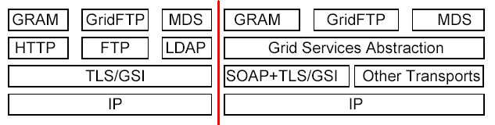
The flexibility of our framework means that such services can be implemented and composed in a variety of different ways.

Slide 150
3.2.10 Summary
  We have defined an Open Grid Services Architecture (OGSA) that supports, via standard interfaces and conventions, the creation, termination, management, and invocation of stateful, transient services as named, managed entities with dynamic, managed lifetime.

Slide 151
  Within OGSA, everything is represented as a Grid service, that is, a (potentially transient) service that conforms to a set of conventions (expressed using WSDL) for such purposes as lifetime management, discovery of characteristics, notification, and so on.

Slide 152
  Grid service implementations can target native platform facilities for integration with, and of, existing IT infrastructures.
  Standard interfaces for creating, registering, and discovering Grid services can be configured to create various forms of VO structure.

Slide 153
  The merits of this service-oriented model are as follows.
    All components of the environment are virtualized. By providing a core set of consistent interfaces from which all Grid services are implemented, we facilitate the construction of hierarchal, higher-order services that can be treated in a uniform way across layers of abstraction

Slide 154
    Virtualization also enables mapping of multiple logical resource instances onto the same physical resource, composition of services regardless of implementation, and management of resources within a VO based on composition from lower-level resources.

Slide 155
    It is virtualization of Grid services that underpins the ability for mapping common service semantic behavior seamlessly onto native platform facilities

Slide 156
  The development of OGSA represents a natural evolution of the Globus Toolkit 2.0, in which the key concepts of factory, registry, reliable and secure invocation, etc., exist, but in a less general and flexible form than here, and without the benefits of a uniform interface definition language.

Slide 157
  The development of OGSA also represents a natural evolution of Web services. By integrating support for transient, stateful service instances with existing Web services technologies, OGSA extends significantly the power of the Web services framework, while requiring only minor extensions to existing technologies.

Slide 158
Reference
1. The Anatomy of the Grid:Enabling Scalable Virtual Organizations
Ian Foster, Carl Kesselman, Steven Tuecke
2. An Open Grid Services Architecture for Distributed Systems Integration
Ian Foster, Carl Kesselman, Jeffrey M. Nick, Steven Tuecke

